Slide 1

Welcome
Async best-practices
webinar
Notes:
A warm welcome to this first webinar in the async webinar series.
Today we talk about Async best-practices

Slide 2

Solution Architect
Enthusiastic Software Engineer
Microsoft MVP for systems integration
@danielmarbach
particular.net/blog
planetgeek.ch
Notes:
I’m Daniel, Solution Architect…
I live in central Switzerland. If you want to know more about me listen to episode 77 of developer on fire
You can reach me on twitter under @danielmarbach
I blog on the particular blog and on my personal blog
Subscribe after this webinar

Slide 3
Goals
CPU-bound vs IO-bound
Threads and Tasks
Async best-practices
target
Notes:
In this webinar we will learn important terminologies
The difference between CPU-bound and IO-bound
The difference between Threads and Tasks
And a few async best-practices

Slide 4
Terminology
Code
WrapUp
Notes:
This webinar is divided into three parts
Terminology
Code and WrapUp including Q&A

Slide 5
Terminology
Code
WrapUp
Notes:
Before we dive deep into code I’m going to talk important terminologies.

Slide 6

async
event-driven
Notes:
Async in the real world can be compared to me doing the laundry. I put my dirty clothes into the machine and select the program or timer and let the machine do its work. Until the laundry is done, indicated by a beep of the machine, I can carry on with other things like reading the newspaper, playing with my kid…
So I, the worker, am free until signal indicates external task is done
This is very similar to software
Asynchronous program
dispatches tasks to devices that can take care of themselves, leaving the program free to do something else until it receives a signal that the results are finished
Asynchronous programming should be used for external operations which support event-driven callbacks when they are done.
Usually that is the case for IO-bound work.
For example on windows IOCompletionPorts signal the result of a IO operation back to the initiator of the operation
Async operation can be more efficient, since the worker initiating the work are not blocked.

Slide 7
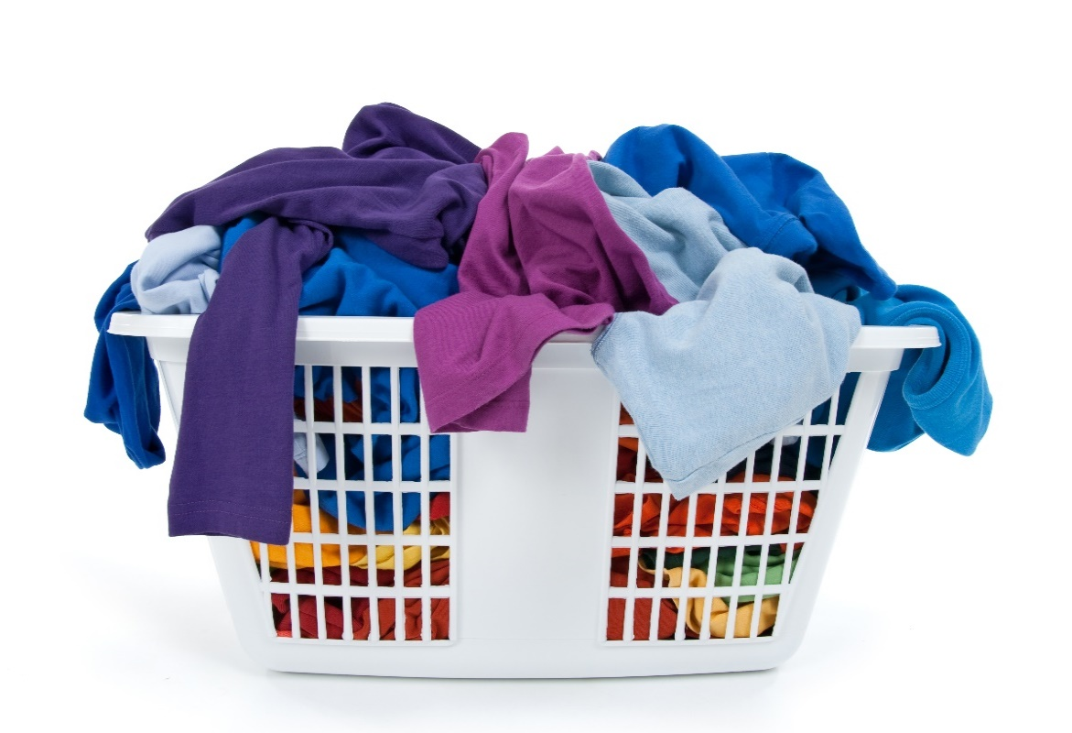
Task
uniform
Notes:
System.Threading.Task is an abstraction layer which represents both CPU bound and IO-bound operations as a uniformed API
Represents the state and outcome of an asynchronous operation executed now, later or never
This is very similar to washing clothes.
If Task represents an IO-bound operation then, we could compare it to

Slide 8
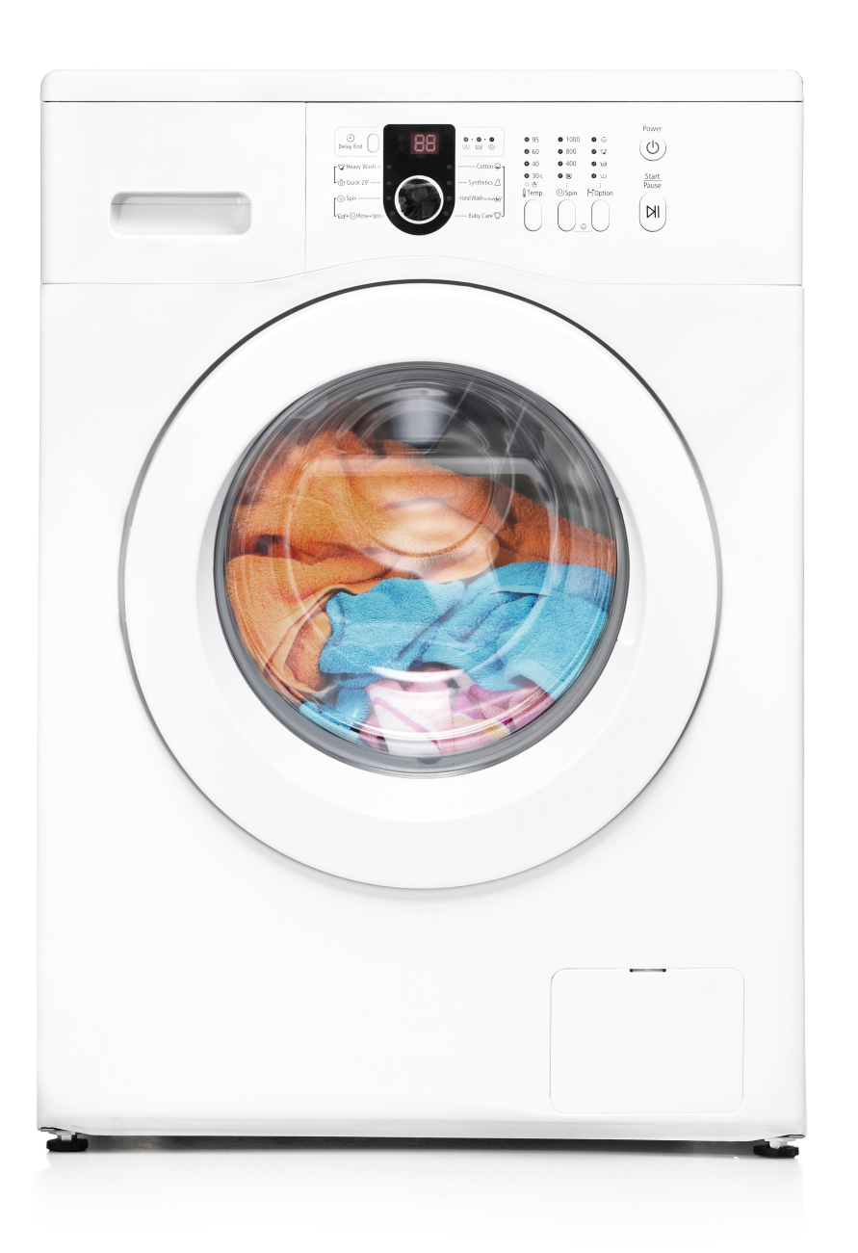
Task
IO-bound
Notes:
The laundry machine
So the state of the task representing the laundry machine would be running, not running, completed
The outcome should be clean clothes
I can late start the machine with a timer, or the machine can decide to run a health check before the process starts
It is also possible that because of failures the machine never starts
Or even more likely my wife cancels the process because yet again I’ve chosen the wrong temperature
The CPU-bound task

Slide 9

Task
CPU-bound
Notes:
Can be compared to me doing the laundry manually
No matter whether the task is IO or CPU bound, Threads are the workers responsible for getting Tasks done that are scheduled
But with CPU bound tasks the worker thread is blocked
So that means a thread can only handle one CPU-bound task at a time
In contrast
A thread can handle multiple IO-bound tasks concurrently

Slide 10
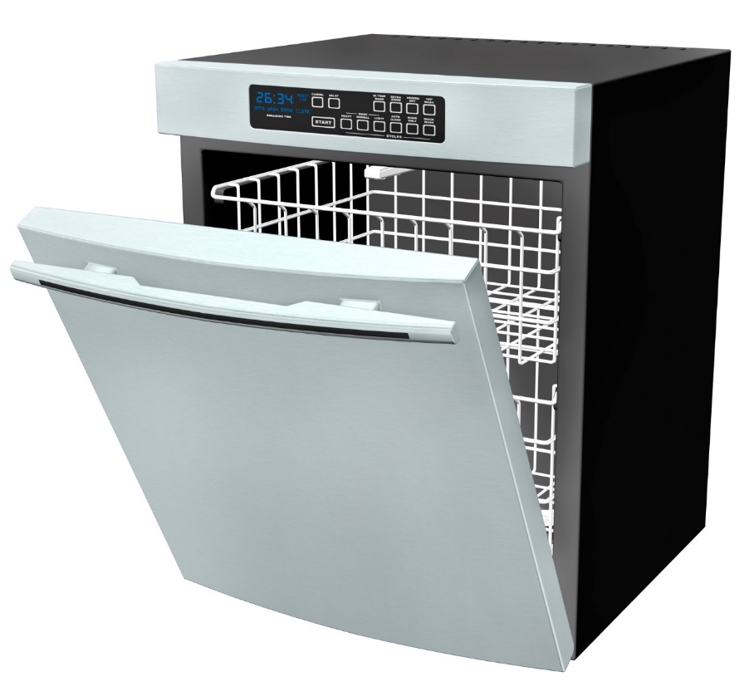

concurrent
concurrent
concurrent
concurrent
concurrent
interleaved
Notes:
Concurrent is like me while doing the laundry, I walk into the kitchen, put my newspaper away, fill the remaining dishes into the dishwasher and start the dishwasher and go back to reading the newspaper
In software this means
There is a coordinator called Scheduler which deals usually on a single thread with multiple concurrent work items
These work items can be interleaved
Depending on the scheduler work can still be distributed over threads and processors, but doesn’t have to

Slide 11
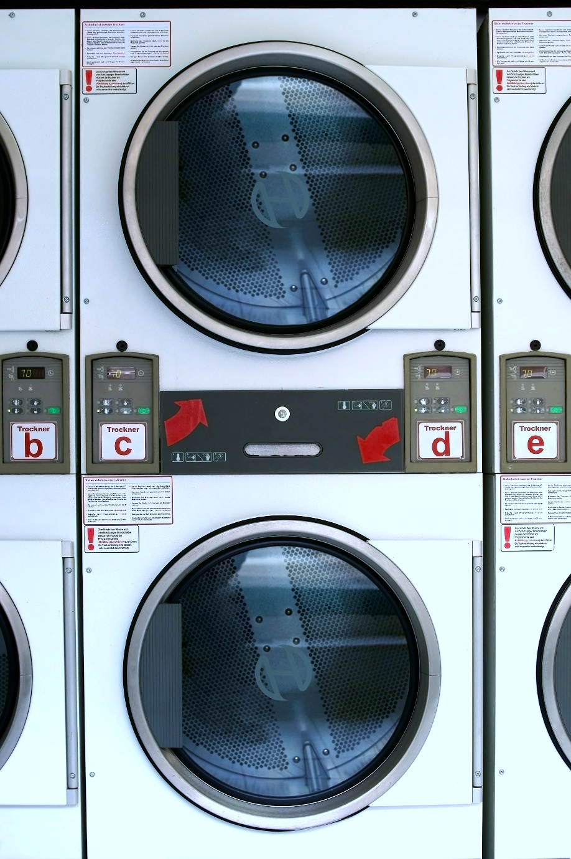
parallel
parallel
simultaneous
Notes:
Parallel can be compared to the laundromat. Multiple people can do their laundry in parallel.
In software this means
A parallel program means
Independent subexpression are evaluated simultaneously on different processors or thread
Goal: Finish computation faster
Ideally suited for CPU bound work such as sorting data in-memory, filter data
To be able to benefit from parallelism the problem needs to be dividable into induvial sub items which can be worked on independently
You can achieve parallelism using concurrency constructs but not the other way around

Slide 12
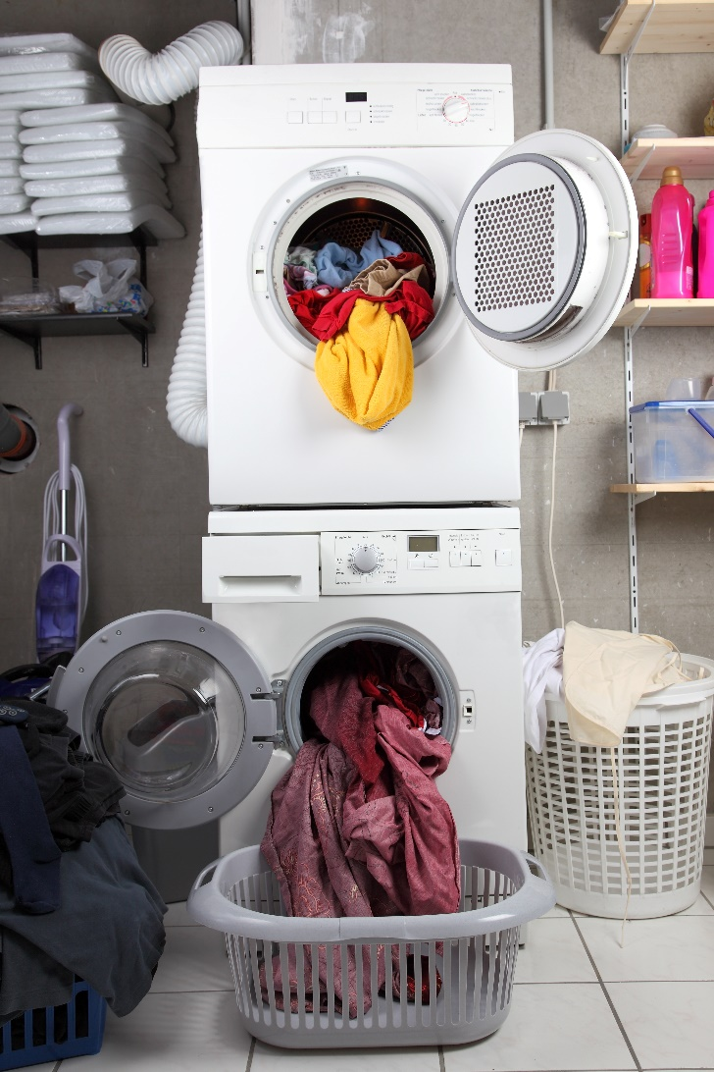
Continuation
function
Notes:
When the laundry is done, I can take out the clothes and dry them in the dryer. So drying is a continuation of the laundry.
In asynchronous programming a continuation is
A function that is scheduled for execution after its prerequisite function has completed

Slide 13
Terminology
Code
WrapUp
Notes:
Now we set the baseline with the terminologies. Let’s dive into code.

Slide 14
function1(function(err, res) { function2(function(err, res) { function3(function(err, res) {
function4(function(err, res) {
function5(function(err, res) {
// do something useful
})
})
}) }) })
async/await
simplicity
Notes:
The async/await keywords are here to reduce the nesting of continuations, also called christmas tree programming, and therefore simplify code drastically.
Asyn/wait is Syntactic sugar augmented with compiler magic

Slide 15
cleanLaundry.ContinueWith(t => {
dryLaundry;
})
Notes:
So instead of we can write

Slide 16
await cleanLaundry;
dryLaundry;

Slide 17
Demo
await

Slide 18
Terminology
Code
WrapUp

Slide 19
Task
Forget thread!
think
Notes:
Stop thinking in threads. For most applications threads are no longer relevant. Think in Tasks. Rest assured the TPL runtime is heavily optimized for most production scenarios.

Slide 20
Will be Async all the way
Applies the shown best-practies like ConfigureAwait(false) consequently, checked with Roslyn analyzer
NSB v6
particular.net/blog/async-await-its-time
Notes:
But how does this relate to the yet to be release NServiceBus Version 6

Slide 21
Use Task.Run, Factory.StartNew for CPU-bound work Use Task directly for IO-bound work
Use async Task instead of async void
Recap
reminder

Slide 22
Recap
Libraries and frameworks should use ConfigureAwait(false)
Async all the way, don’t mix blocking and asynchronous code
reminder

Slide 23
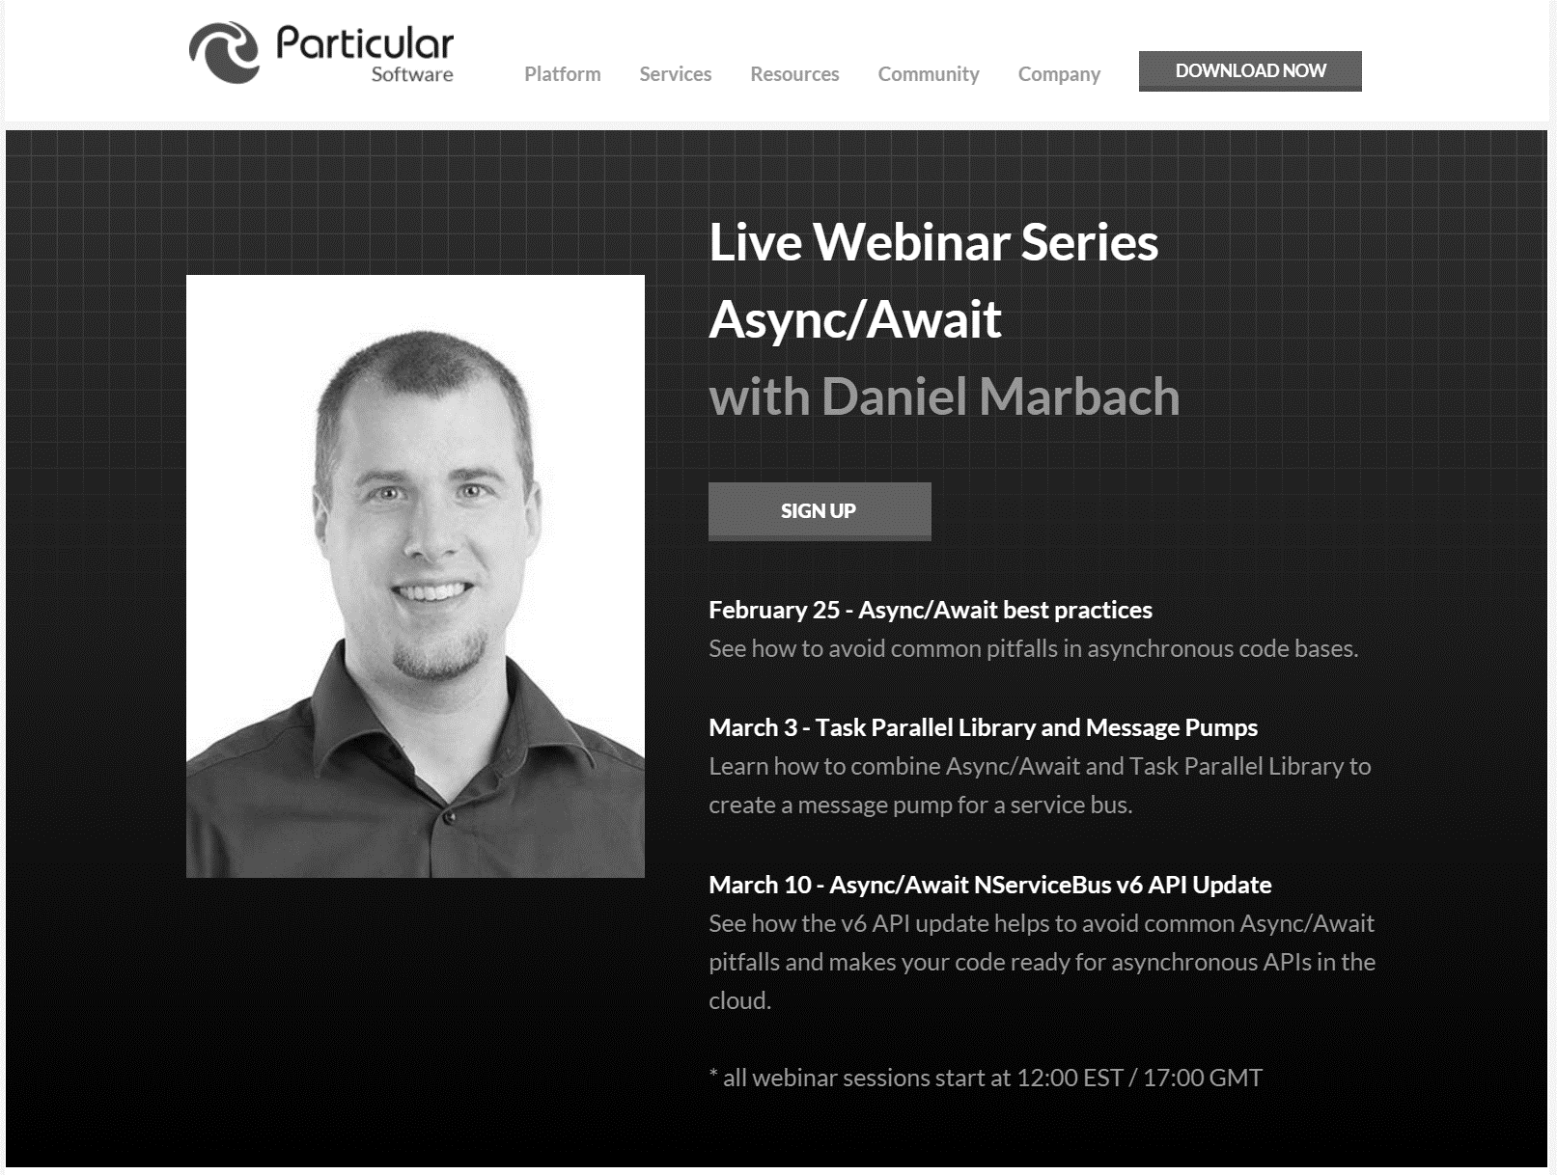
particular.net/async-await-webinar-series
Next
Notes:
In the next webinar we will dive deeper and write a message pump for a service bus which combines async/await with TPL
We’ll learn where TPL contains unpleasant surprises and how we can work around those
Join again, invite your friends and learn to apply more than just the basics of async/await

Slide 24
Slides, Links…
github.com/danielmarbach/02-25-2016-AsyncWebinar
Notes:
Questions that can be answered in blog posts

Slide 25
Q & A
await
Notes:
Reduces christmas tree programming to code which looks much

Slide 26
Thanks
Notes:
Thank you very much for listening and see you next time

